Slide 1

Manor Primary School
September 2022
Welcome!

Slide 2
Attendance
Regular attendance is an important part of fostering a positive attitude to school. We provide regular attendance reports throughout the year, and rewards and certificates for those children with over 95% attendance.
If your child is absent, or will arrive late because of an appointment elsewhere, please send an explanatory note, telephone the school and leave a message on option 1, or speak to your keyperson.
If you do have difficulties getting your child to school for some reason please come and discuss the situation with us. If no satisfactory explanation is given for persistent non-attendance, then parents receive a letter inviting them in to review the matter. If there is still no improvement in the attendance, the Foundation Stage place may be withdrawn.
From September 2013 the Government issued a new directive stating the no leave of absence will be granted. However, in very exceptional circumstances, discretionary leave may be given by the Headteacher of the school. If holiday is unauthorised this will feature on the school registers. Once the pupils are of statutory school age Education Welfare Services become involved and you may be given a fixed penalty notice for non-attendance.

Slide 3

Parentpay.com
All children starting in Reception until the end of Year 2 are entitled to Universal Infant Free School Meals (UIFSM) due to the Government scheme since 2014.
Parents are to order their child’s meals through the system called Parentpay.com at no charge until they start in Year 3.
Once your child starts with us we can generate an activation letter which will guide you through registering with Parentpay.com. (also see next slide)
A hot meal and pudding option must be selected for each day required.
Remember to select your child’s meal no later than 9pm the night before. However, you are able to book weeks in advance.
If you know your child will not be at school the following day you can unselect the meal choice before 9am to cancel the order.
Please register with Parentpay.com even if your child prefers to have packed lunch.
Please let the school office know if your child suffers with any food allergies as a special medical diet maybe required.

Slide 4
Parentpay.com
Activate a new account
You’ll need an activation letter from school to get started. If you have lost this or not yet received it, contact the school.
You need a valid email address as a username and for account verification.
Navigate to parentpay.com
Select Login at the top right corner of the screen
Enter the username and password provided in your account activation letter and select Activate
Complete the activation as detailed on the screen.
That’s it you’re done!

Slide 5
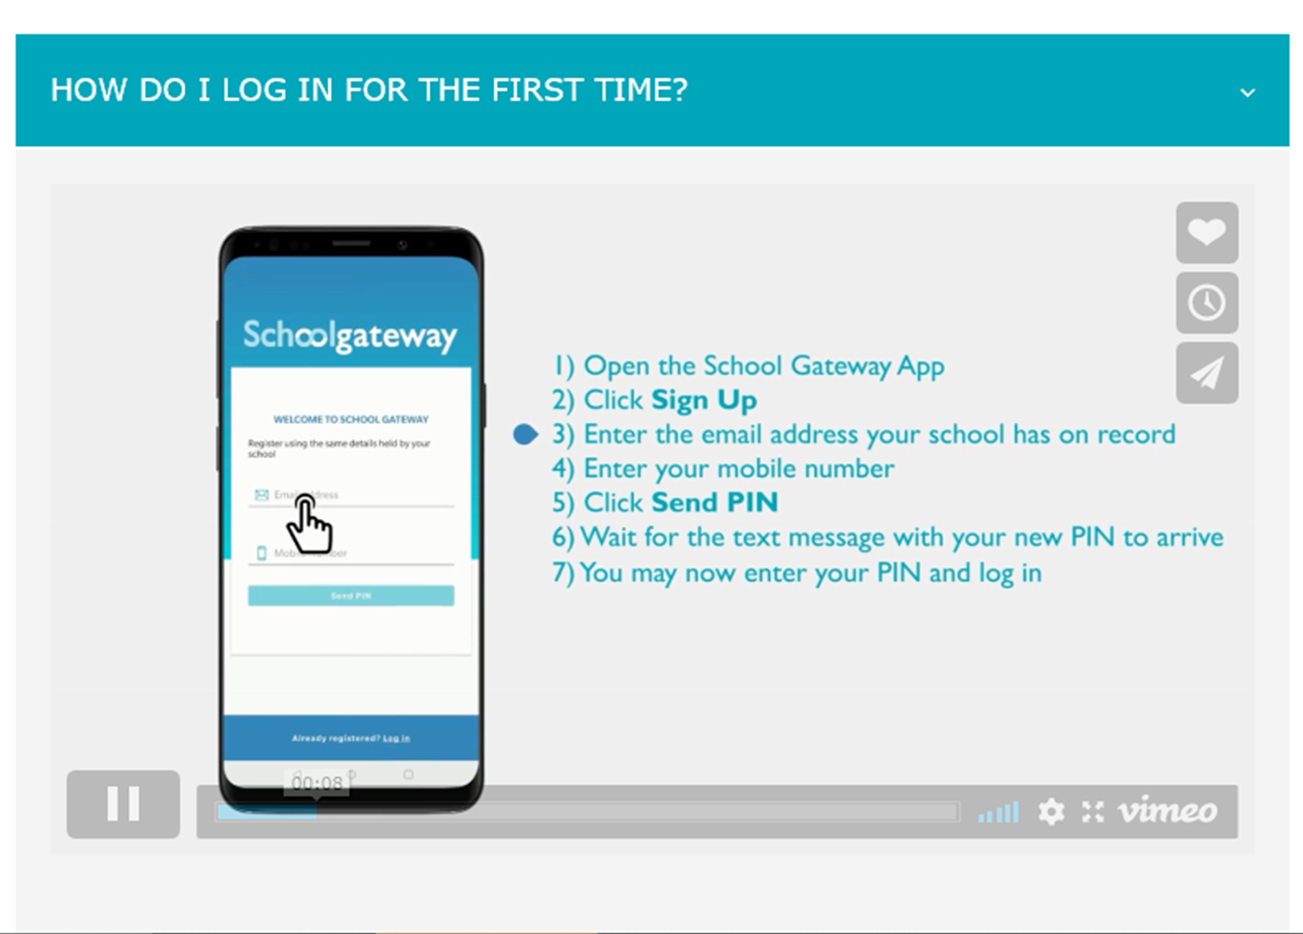
Schoolgateway.com
Schoolgateway.com is our preferred communication system. We send emails and text messages to parents via this system and parents can text replies or queries through this same system.
It would help us tremendously if all parents could sign up to the free Schoolgateway.com app as we are charged for every text message sent but the app messages are free!

Slide 6





Uniform
All pupils are expected to wear school uniform. You can order our school uniform with school logo’s through Mapac.com or visit the parents page on our school website, Manorprimary.net where you will find a link or buy any brand from other shops provided they are in our school colours.
White polo-shirts, shirts or blouses.
Bottle Green cardigans or jumpers/sweatshirts either Air, Earth, Fire or Water house (if you are unsure which house your child is in please contact the school office before ordering)
Grey trousers, skirts, pinafores or shorts.
Yellow t-shirt for PE.
Bottle Green or Black shorts for PE.
Black or dark school shoes.

Slide 7
Breakfast Club
8:00 – 8:30 £1.50 per child per day
We offer our Breakfast club which open 8:00 everyday. Children are supervised onsite by our own staff and escorted to class at 8:30.
This should be pre-booked and paid for through Schoolgateway.com under Clubs, however, you can turn up and pay on the morning.
The food options are toast, cereal or crumpets. Strawberry jam, marmite or spread.
The drink options are cold milk, apple or orange juice, orange or apple and blackcurrant squash or water.
If you have any queries please contact the school office 0118 9375494.

Slide 8
Twilight Club
15:00 – 17:00 £5.00 per child per day
We offer our Twilight club everyday. Children are supervised onsite by our own staff and have a varied timetable to keep them busy and engaged.
This should be pre-booked and paid for through Schoolgateway.com under Clubs. Booking will close 2pm that day. If you would like to book your child in after the booking window has closed please call the school office.
They will be offered toast and squash during their session.
Any late pickups is to be discouraged as a penalty charge will incur.
If you have any queries please contact the school office 0118 9375494.

Slide 9
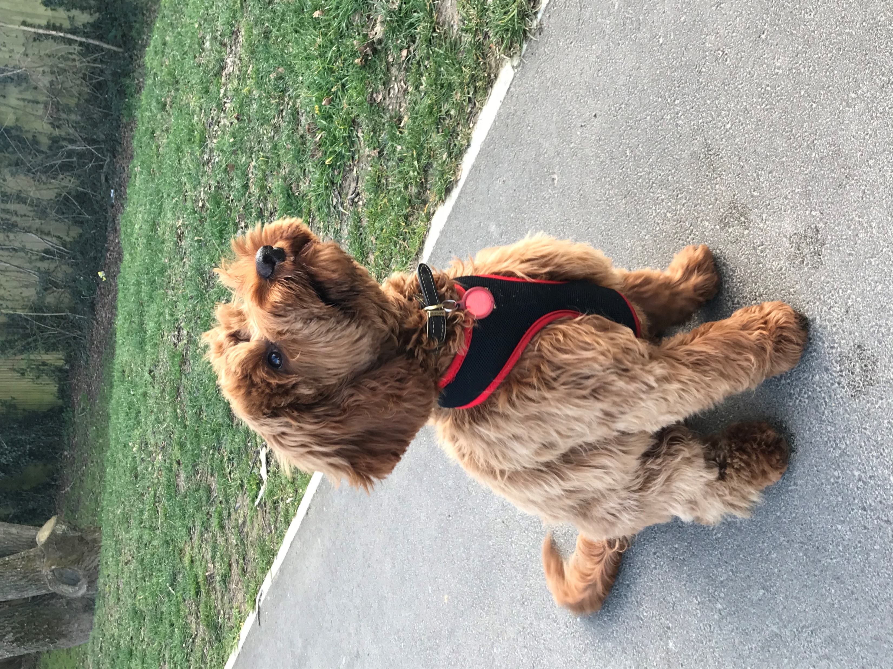
Barley our school dog!
As of April 2021, we welcomed Barley, our school dog, into school for x 2 half days to work with our pupils.
Barley will be undergoing specific and on-going training with the Canine Assistance Programme, to ensure he is well-trained for being around children. We wish to reassure parents that we have undertaken a significant amount of research and believe the positive effects of such demonstrably outweigh any negatives.
We hope you will join us in welcoming Barley to our school and embrace all he has to offer to our community.

Slide 10

Tapestry – Your child’s Learning Journal
Many of you will already using the system called Tapestry where your child’s keyworker can post pictures and comments on work and activities your child does during the day.
Those that already have access to Tapestry through our nursery will continue to use that login.
For our new starters, an email with a link to log in through will be generated once your child starts with us, please keep an eye on your emails and check your junk folder.
Enjoy watching your child engage, create and achieve!

Slide 11
Useful contacts
School website - manorprimary.net
School office - 0118 9375494
School address - 110 Ashampstead Road, Reading, RG30 3LH

Slide 12
We look forward to welcoming you all in September 2022

